Slide 1
aa 4.3: new features
Tibor Auer
MRC Cognition and Brain Sciences Unit, Methods group
Notes:
Prepare:
/imaging/ta02/Workshop
Wiki

Slide 2
Automatic analysis (aa) 4.3
Robustness
Running
Summaries
Convenience
Setting up
Running
Results
New features
General
fMRI
MEG
https://github.com/rhodricusack/automaticanalysis/blob /v4-devel/CHANGELOG.md

Slide 3
Robustness
Running
Compatibility with MATLAB pre-r2012b (localsingle only)¹
Iterative file retrieval to overcome network issues (aap.options.maximumretry = 5)
aaworker folders
prevent creation of the useless aaworker0 folder
created in <HOME>/.aa (hidden) folder
cleaned up regularly after certain days (aap.options.aaworkercleanup = 7)
Summaries
Default message for "Motion correction summary“ in case of a single subject
Renaming "First level contrasts" to "First level thresholded maps"
Notes:
1. Setting up/Debugging the pipeline

Slide 4
Convenience
Setting up
Allow specification of subjects in the whole UMS in the same way
aas_addsubject
aas_addevent
aas_addcovariate
aas_addcontrast
aap.options.checktasksettingconsistency (experimental):
Check whether settings have changed since the last execution
Trigger re-execution of the task accordingly regardless of the doneflag

Slide 5
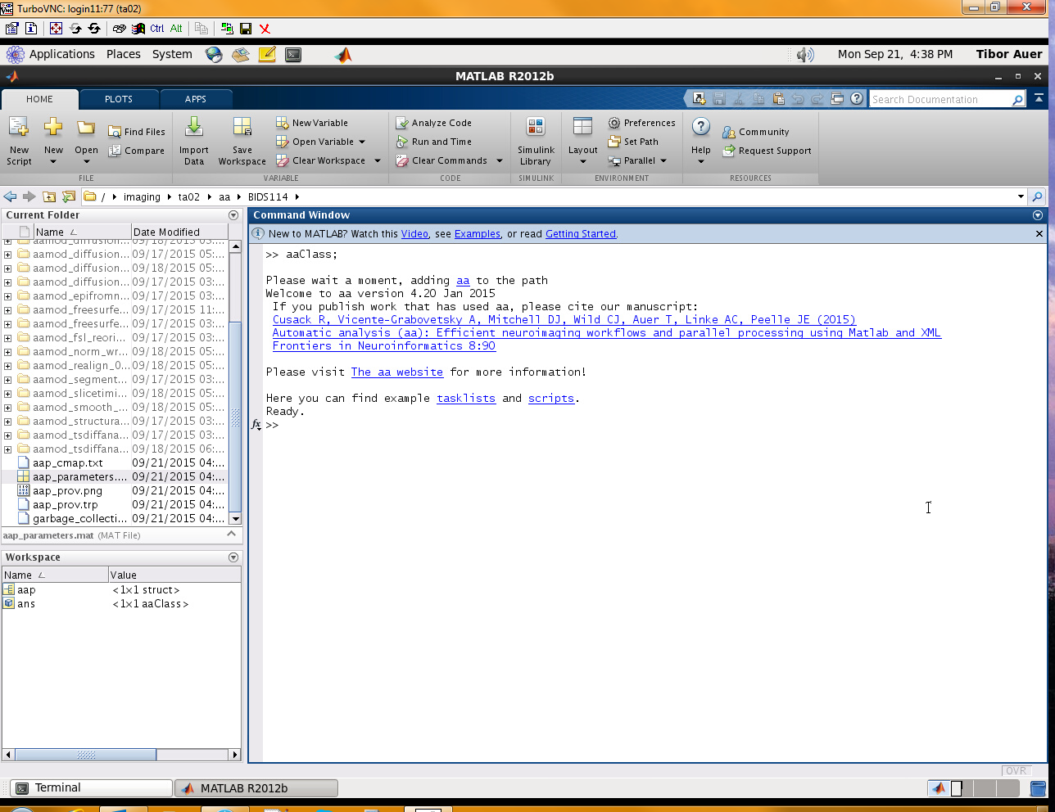
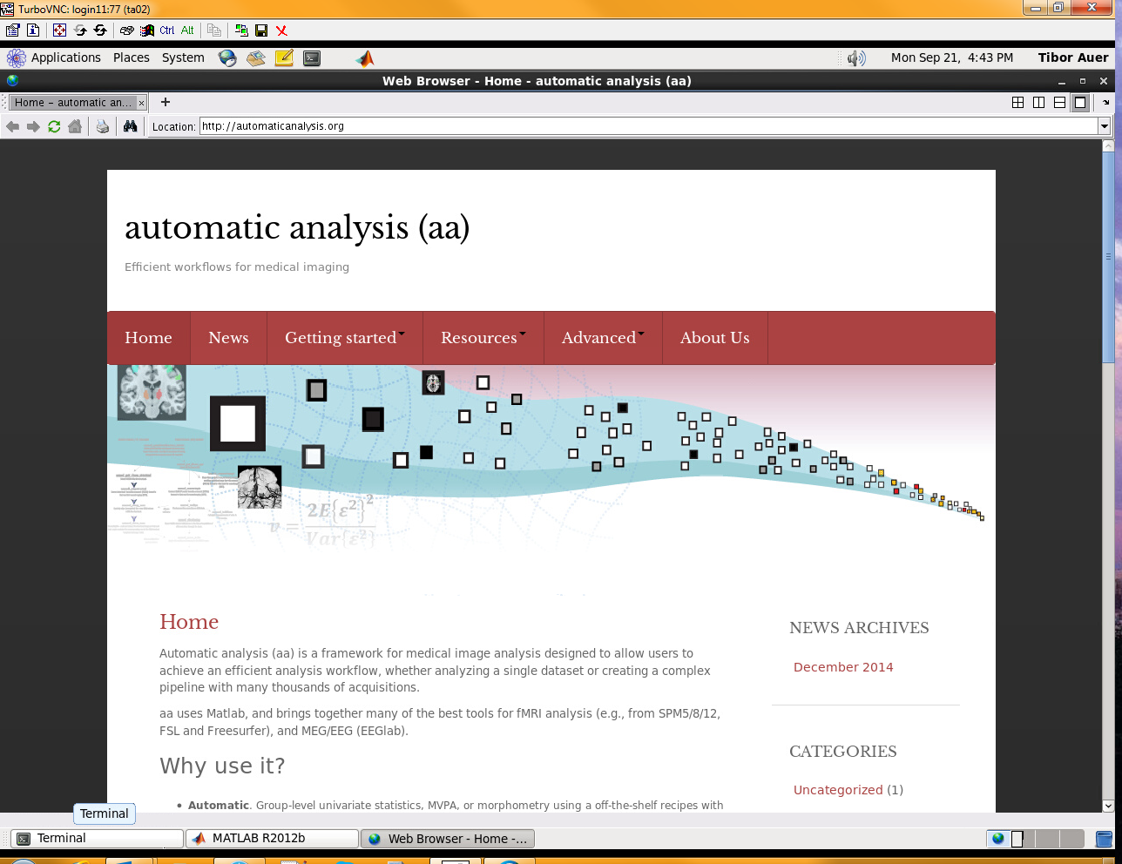
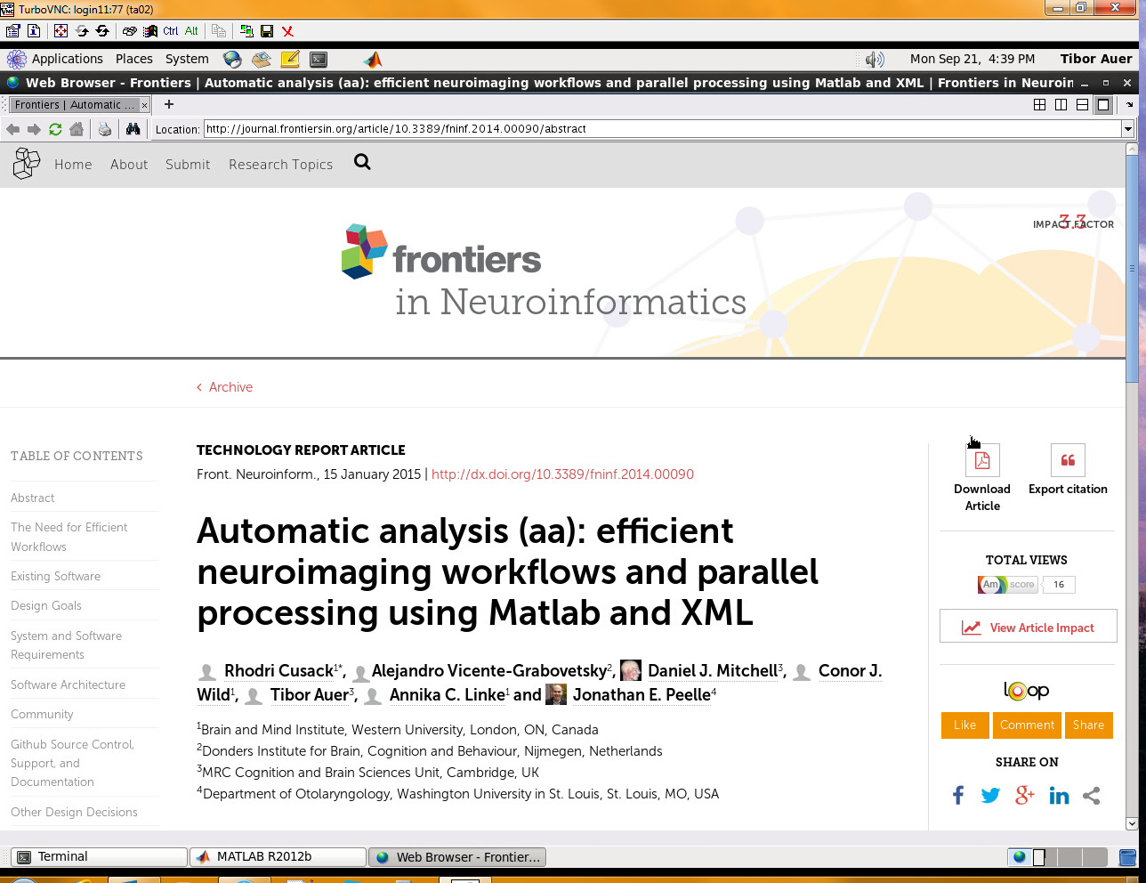
Convenience
Running
aa Intro

Slide 6
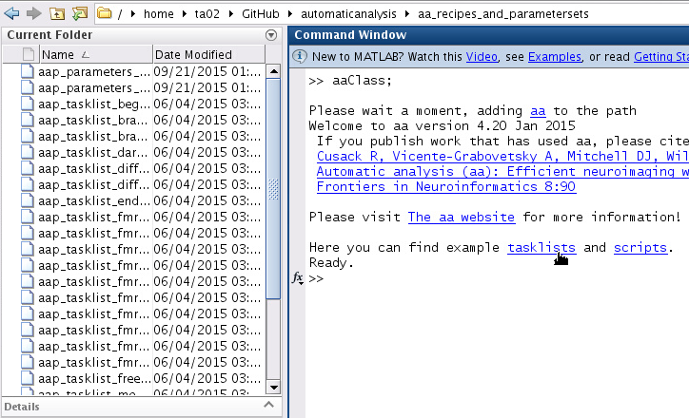

Convenience
Running
aa Intro

Slide 7
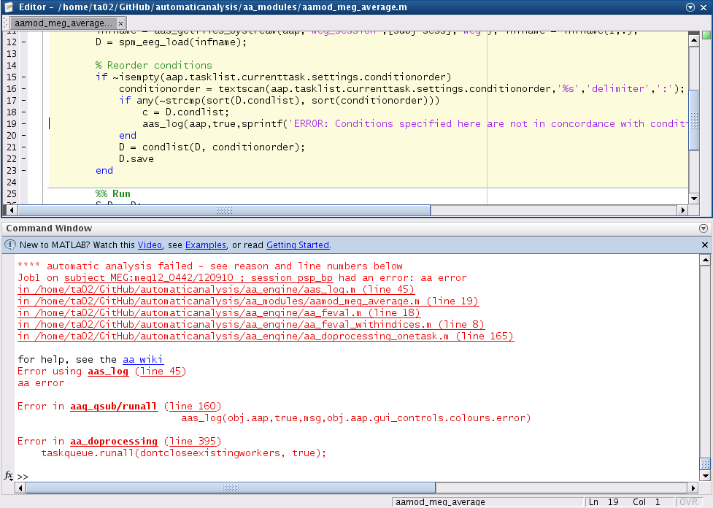
Convenience
Running
qsub provides links to code in case of error

Slide 8
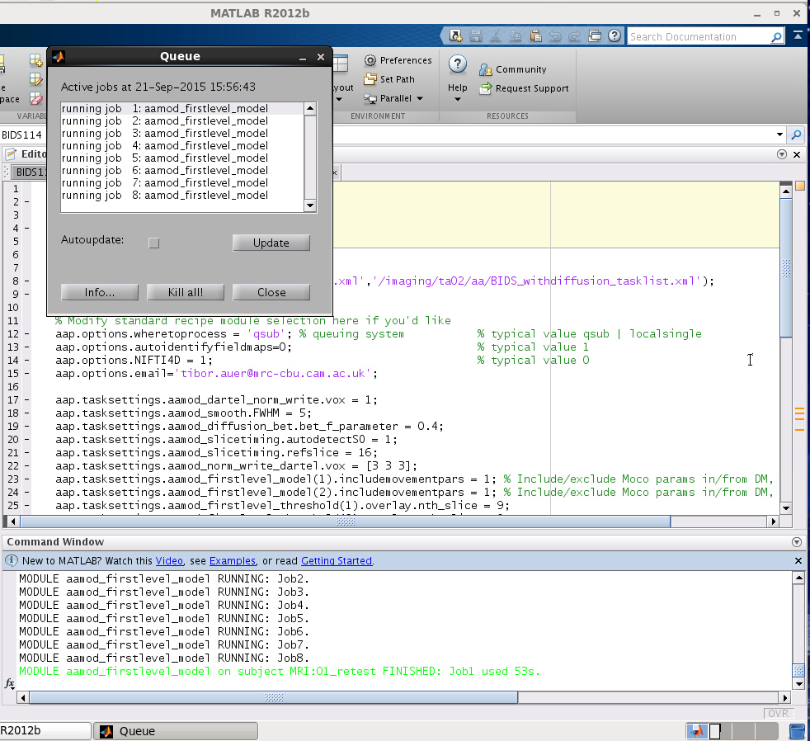
Convenience
Running
GUI for qsub
Main window¹
Notes:
Close → Reopens with updated size

Slide 9
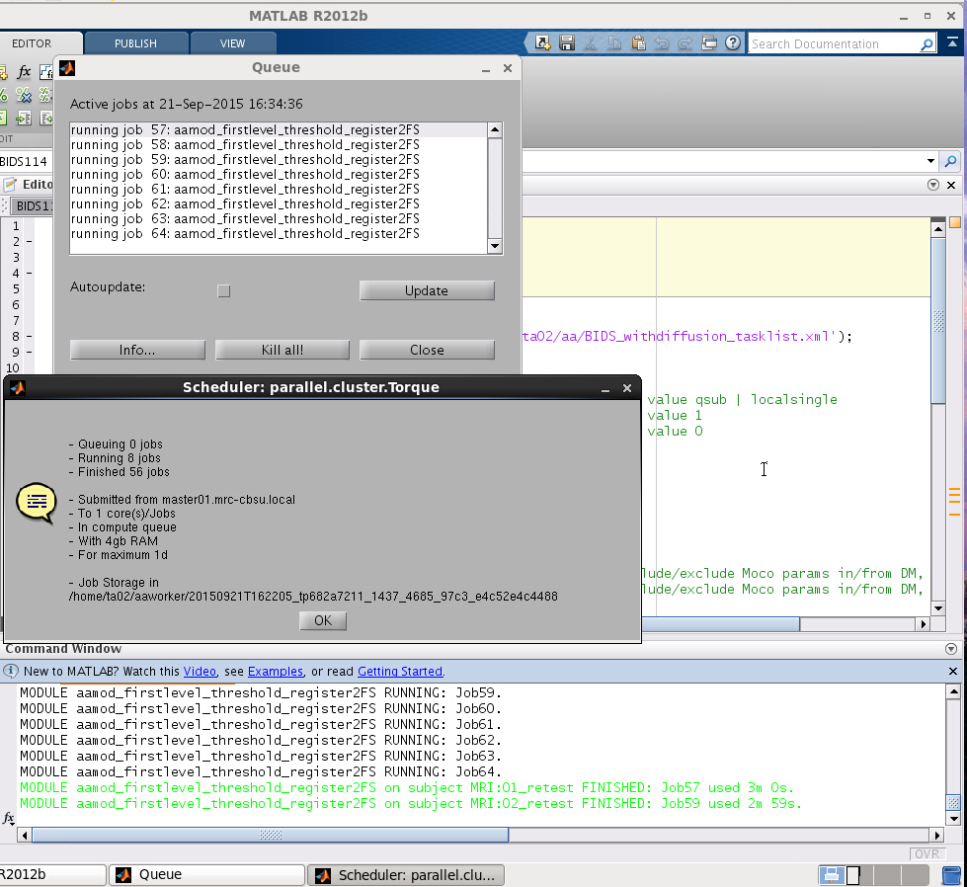
Convenience
Running
GUI for qsub
Info…

Slide 10
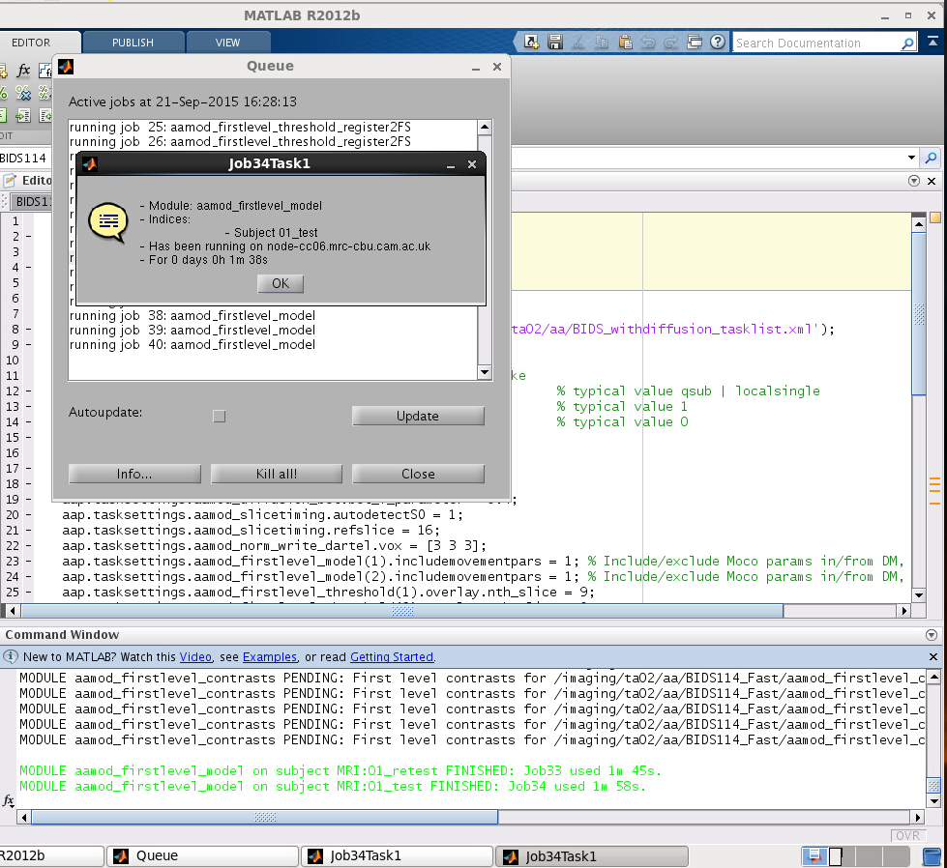
Convenience
Running
GUI for qsub
Job

Slide 11
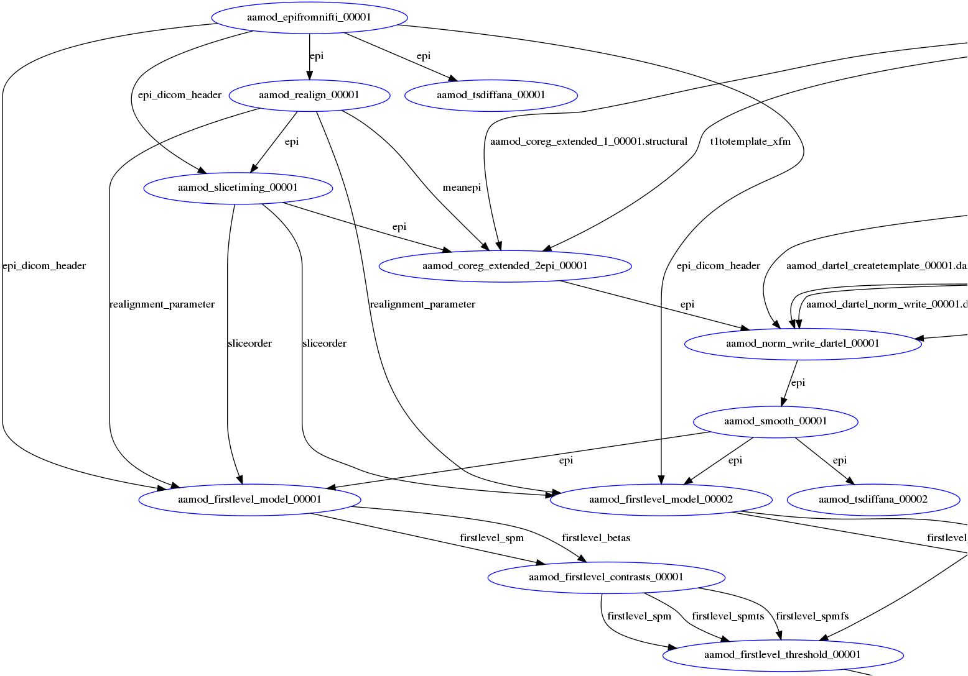
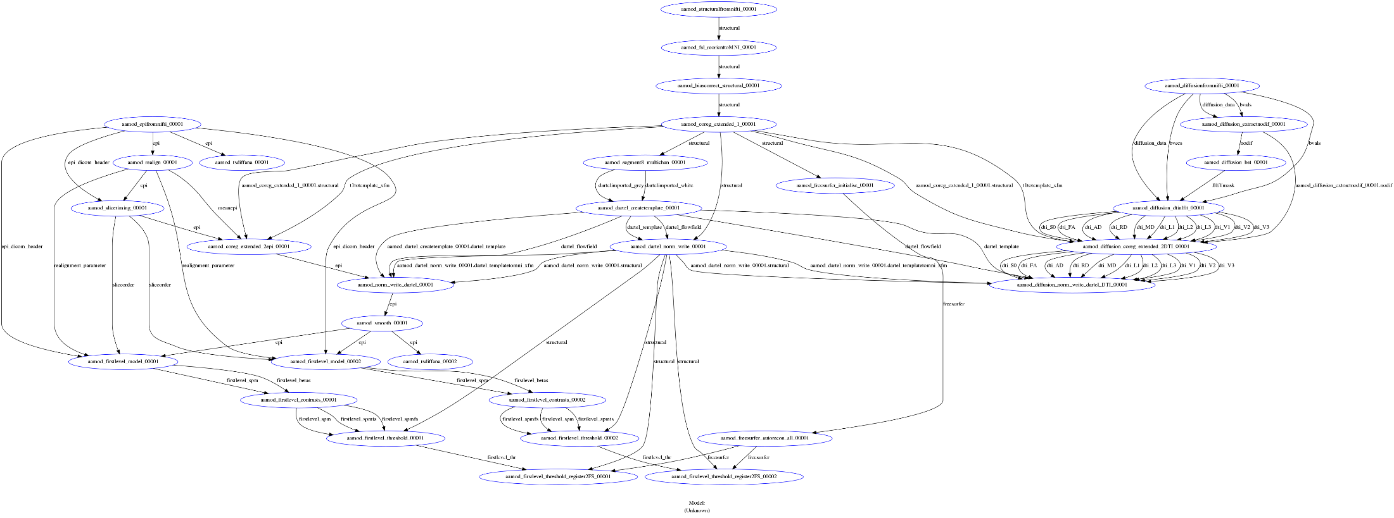
Convenience
Results
Vertical workflow chart

Slide 12
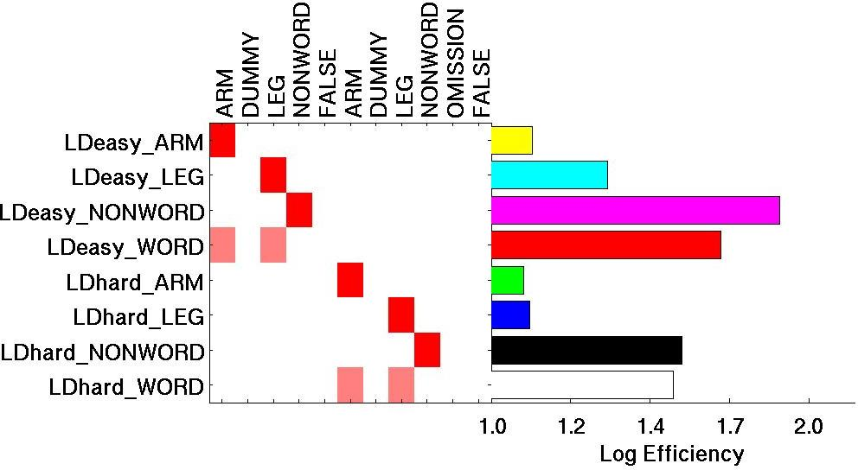
Convenience
Results
Consistent (and nice) graph of contrasts

Slide 13
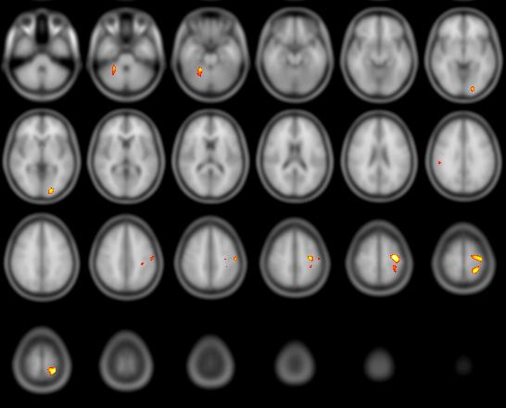
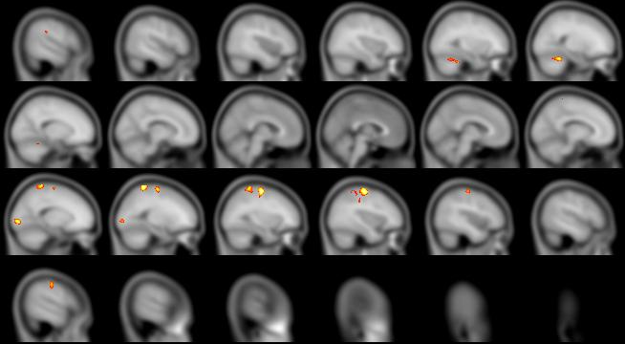
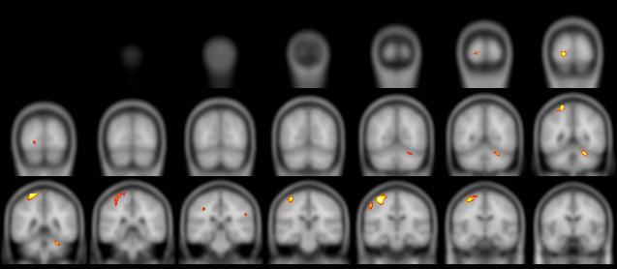
Convenience
Results
aamod_firstlevel_threshold creates overlays across all three axes

Slide 14
New features
General
dynamic modification of streams (aas_renamestream)
E.g.: aamod_maths to calculate resting-state fluctuation amplitude (RSFA)
% Specify equation
aap.tasksettings.aamod_maths.operation = 'std(X,[],4)';
% Use ‘epi’ as input
aap = aas_renamestream(aap,'aamod_maths_00001’,'input','epi');
% Output ‘RSFA’
aap = aas_renamestream(aap,'aamod_maths_00001‘,'output','RSFA','output');

Slide 15
New features
fMRI:
Automatic slicetiming with exact timing from DICOM header aap.tasksettings.aamod_slicetiming.autodetectSO = 1;
Automatic temporal modulation parametric.name = ‘time’ parametric.P = []; parametric.h = <polynomial expansion>; aap = aas_addevent(…,parametric);
Second-level GIFT

Slide 16
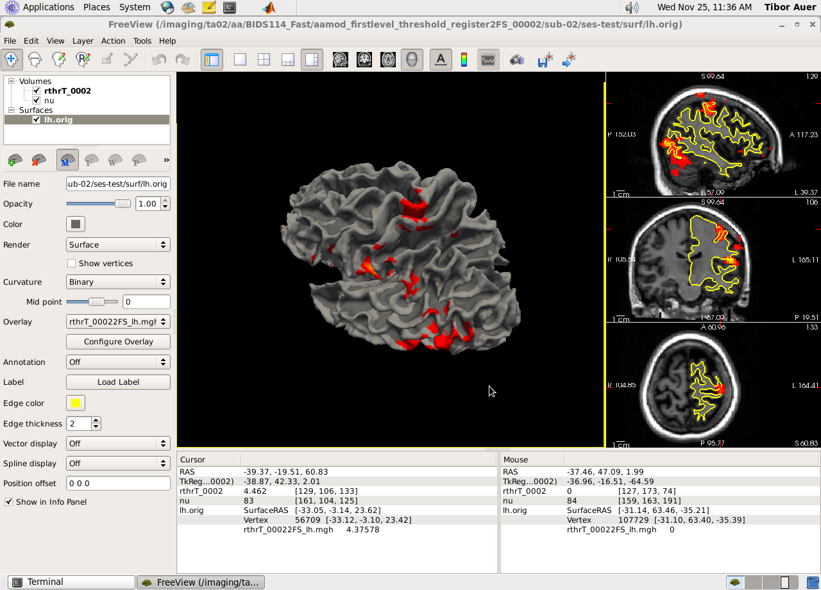
New features
fMRI:
Activation maps projected to surface (FreeSurfer)

Slide 17
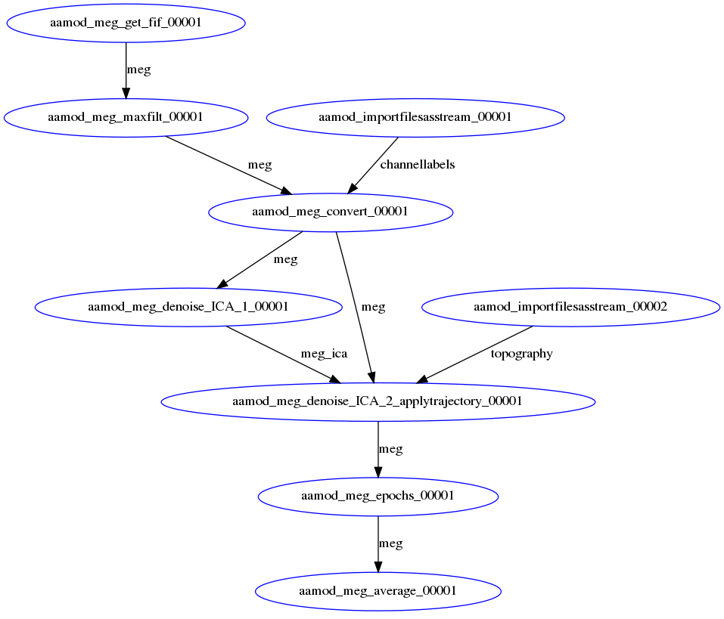
New features
MEG:
Maxfilter
ICA Denoising
Epoching
Averaging

Slide 18

Info/Support
Website: http://automaticanalysis.org
GitHub: https://github.com/rhodricusack/automaticanalysis/blob/v5-stable/README.md
GitWiki: https://github.com/rhodricusack/automaticanalysis/wiki
Our Wiki: http://imaging.mrc-cbu.cam.ac.uk/imaging/AA
Maasters

